Slide 1

Product Recommendation Analysis: A Data Science Project
This project delves into the intricate world of product recommendation systems, leveraging the power of data science to deliver personalized and engaging shopping experiences.
Pavithra M

Slide 2

Introduction to Recommendation Systems
1
Personalized Shopping
2
Increased Sales
Recommendation systems aim to improve customer satisfaction by suggesting products tailored to their individual preferences and needs.
By showcasing relevant items, they encourage purchases and drive revenue growth.
3
Enhanced User Engagement
4
Improved Efficiency
They automate the process of product suggestion, reducing manual effort and enhancing operational efficiency.
Recommendations keep customers browsing and interacting with the platform, fostering a sense of discovery.

Slide 3

Data Collection and Preprocessing
Data Sources
1
Gathering data from various sources, such as user interactions, purchase history, and product attributes, is crucial for effective recommendation systems.
2
Data Cleaning
Preprocessing involves cleaning and transforming raw data into a usable format, addressing issues such as missing values, inconsistencies, and irrelevant information.
Data Transformation
3
Data may be transformed into suitable formats, such as converting categorical variables into numerical representations, to prepare it for modeling.

Slide 4
Exploratory Data Analysis
User Behavior
Product Attributes
Trend Analysis
Analyzing user interactions, browsing patterns, and purchase history reveals insights into customer preferences and interests.
Understanding product features, categories, and relationships helps identify relevant product connections and similarities.
Exploring patterns over time helps identify popular products, seasonal trends, and emerging preferences.

Slide 5

Feature Engineering and Selection
User Features
Product Features
Interaction Features
Extracting relevant information from user profiles, such as demographics, purchase history, and browsing behavior, to create features for modeling.
Creating features from product attributes, such as categories, price range, brand, and reviews, to capture product characteristics.
Building features based on user-product interactions, such as viewing times, add-to-cart events, and purchase frequency.

Slide 6
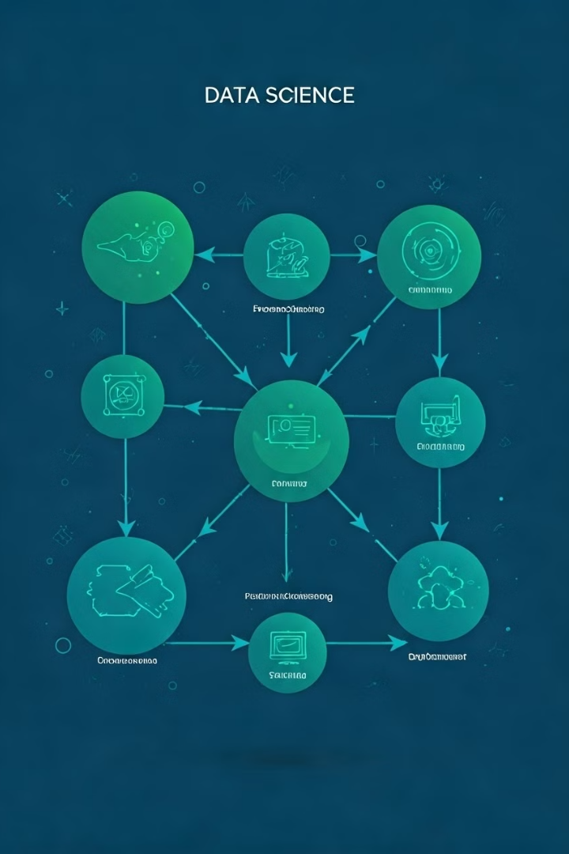



Modeling Approaches
Collaborative Filtering
This approach leverages user-product interactions to find similar users or products, recommending items based on shared preferences.
Content-Based Filtering
This method focuses on product attributes and user preferences to recommend items with similar characteristics.
Hybrid Methods
Combining collaborative and content-based filtering techniques for a more comprehensive and robust recommendation system.

Slide 7

Evaluation and Performance Metrics
Precision
Measures the accuracy of the recommendations, indicating the proportion of recommended items that are relevant to the user.
Recall
Assesses the completeness of the recommendations, measuring the proportion of relevant items that were actually recommended.
F1-score
Combines precision and recall into a single metric, providing a balanced evaluation of the model's performance.
Mean Average Precision (MAP)
Evaluates the average precision at different recall levels, providing a more comprehensive view of the model's performance.

Slide 8





Deployment and Real-time Recommendations
Cloud Deployment
Real-time Processing
API Integration
Continuous Monitoring
Hosting the recommendation system on a cloud platform allows for scalability and accessibility.
Implementing a real-time architecture ensures that recommendations are generated instantly as users interact with the platform.
Integrating the recommendation system with other platforms through APIs enables seamless delivery of recommendations across various channels.
Regularly monitoring the system's performance and analyzing user feedback allows for ongoing optimization and improvement.

